Slide 1
Emotion Detection System Analysis under Partial Occlusion: A Survey IT350:Software Group Project-Sem6 guided By: Asst.professor- Ms.Nishat shaikh(faculty CSPIT) charusat university,Anand,Gujarat,india
Presented By: Neel Shah(18IT124)
Krunal Thakkar(18IT134)
Github Links:
https://github.com/neelshah124/emotion-detection-system-a-survey
https://github.com/krunal43/Emotion-Detection-and-research

Slide 2
Human Emotions
Emotions are often interwined with mood, temperament, personality, motivation and disposition. Human emotions help us cope with everyday life allowing us to communicate with everyday life, allowing us to feel towards certain situations, people, things, thoughts, senses, dreams, and memories.
Many psychologists believe that there are six main types of emotions, also called basic emotions. They are happiness, anger, fear, sadness, disgust and surprise.

Slide 3
Objective
To analyze the limitations of the existing system emotion detection using different methods and technologies.
To understand the processing of the system.
To compare accuracy and processing power of different technologies and methods.
Find the difference between grayscale and multicolored image processing power.
Work on deepface framework.
Give final survey on the overall analyzation.
Conclude with pros and cons of all methodologies.

Slide 4
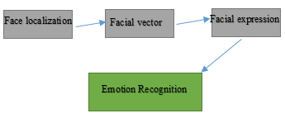
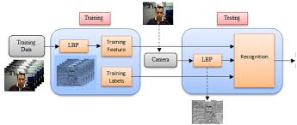
How Emotion detection system works
Most of the existing literature about face expression recognition systems decomposes the image processing of facial expressions into the following steps:
Face localization on the image.
Facial feature vector extraction and representation.
Facial expression recognition.
Emotion recognition.
Not all the systems follow these steps up to a point but they are the building blocks for these systems.

Slide 5
Major aspects
CNN(Convolutional Neural Network)
ANN(Artificial Neural Network)
Deep learning
Keras libraries
Machine learning
Python programming
OpenCV
Tensorflow
Pandas libraries
Numpy libraries
Matplotlib libraries

Slide 6
Use of emotion detection system
Psychological treatment of humans
Armed forces
Medical
Security
Entertainment
AR/VR
Artificial intelligence
Automation
Cyborg

Slide 7
Drawbacks of emotion detection system
Invasion of privacy
Wrong interpretatation
Less robust
Less reliable
Misused for miscellaneous purposes
Theft
Hurt personal emotional feelings
Requires high processing power
Not so accurate and precise

Slide 8
System prospects
Image based reognition:
Neural network:
3D
2D
Still image
Active appearance
Appearance based:
Linear
Non linear
Parameters for still image:
Active contours
Blobs
Colour
Edges
Gabor wavelet
Local PCA
Template
Parameters for active appearance:
Local PCA
2D Discrete Cosine transform
Optical Flow
Image difference
Grayscale
Edges

Slide 9
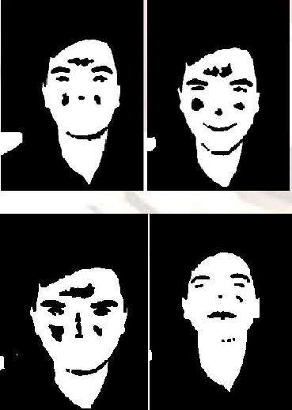
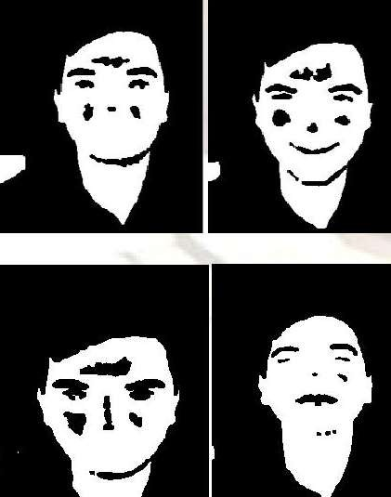
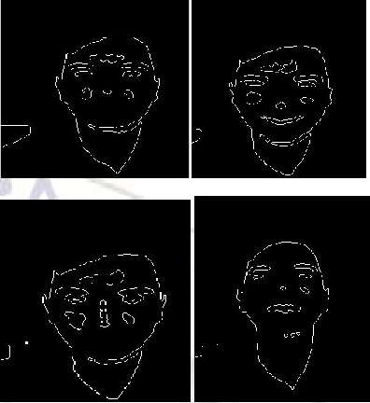
Process:
Knowledge based:
It contains images which we will use for comparisons for the sake of emotion recognition. These images are highly qualified and these are stored in given database.
Pre-processing and resize
The image pre-processing procedure is a very important step in the facial expression recognition task. The aim of the pre-processing phase is to obtain images which have normalized intensity, uniform size, and shape.
Pre-processing step
After pre-processing
Edge detection

Slide 10
Face feature extraction
One common method is to extract the shape of the eyes, nose, mouth, lips and chin, then distinguish the faces by distance and scale of the organs.
Eg:-
Feature1 width of left eye
Feature2 width of right eye
Feature3 width of nose
Feature4 width of mouth and lips
Feature5 width of face

Slide 11
Face detection and emotion detection
Face localization aims to determine the image position of a single face, this is a simplified detection problem with the assumption that an input image contains only one face.
If the feature of face have n dimensions then the generalized Euclidean distance formula is used to measure the distance.
Detection of emotion is based on the calculation of distances between various features points. In this step comparison between distances of testing image and neutral image is done and also it selects the best possible match of testing image from train folder.

Slide 12
Future work:
Compare the keras implemented system with other implementations like deepface(emotion detection framework for Opencv and tensorflow)
Pretrained models (like the one used currently emotion_detection.h5) i.e. keras trained model
Analyze using different pre trained models available online.
Compare and analyse with system using matlab.
Give regression graph presentation of the systems
Compare the accuracy and processing powerof different implemented systems.

Slide 13
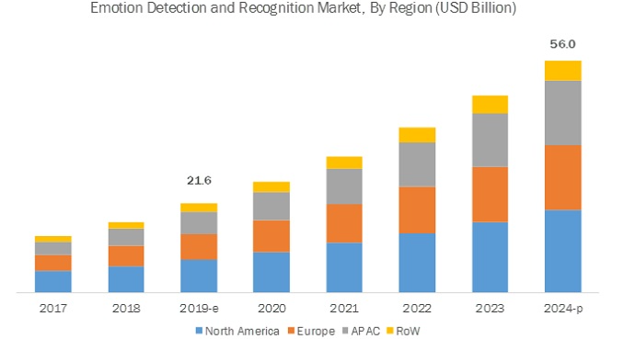
Future scope:
The global emotion detection and recognition market size is projected to grow from USD 21.6 billion in 2019 to USD 56.0 billion by 2024, at a Compound Annual Growth Rate (CAGR) of 21.0% during the forecast period(2018-19). Factors such as the rising need for socially intelligent artificial agents, increasing demand for speech-based biometric systems to enable multifactor authentication, technological advancements across the globe, and growing need for high operational excellence are expected to work in favor of the market in the near future.
Source: marketsandmarkets.com

Slide 14
References:
https://www.youtube.com/watch?v=PulKlAZRoAY
https://www.youtube.com/watch?v=bYvNY8TqIO4
https://www.youtube.com/watch?v=Bb4Wvl57LIk
https://www.youtube.com/watch?v=fkgpvkqcoJc&t=80s
https://www.youtube.com/watch?v=avv9GQ3b6Qg
https://www.youtube.com/watch?v=0O0otPBtbXs
https://www.youtube.com/watch?v=ou-uhY4616A
Proceedings of the Federated Conference on Computer Science
and Information Systems pp. 1631–1640
DOI: 10.15439/2016F535
ACSIS, Vol. 8. ISSN 2300-5963
Facial Expression Analysis under Partial Occlusion: A Survey*1
Ligang Zhang1, Brijesh Verma1, Dian Tjondronegoro2 and Vinod Chandran3
1Central Queensland University
2Southern Cross University
3Queensland University of Technology
https://www.researchgate.net/publication/267229317
International Journal of Engineering and Applied Sciences (IJEAS) ISSN: 2394-3661, Volume-3, Issue-2, February 2016
Proceedings of the Federated Conference on Computer Science
and Information Systems pp. 1631–1640
Limitations of Emotion Recognition in Software User Experience
Evaluation Context
Agnieszka Landowska, Jakub Miler
Gdansk University of Technology, Narutowicza St. 11/12, 80-233, Gdansk, Poland
Standard references:
Wikipedia
Nvidia
https://ieeexplore.ieee.org
Coursera.org

Slide 15


